Slide 1

The Aga Khan Hospital Dar es Salaam
FMC Nurses - OPA Documentation Compliance for Q4 2022

Slide 2
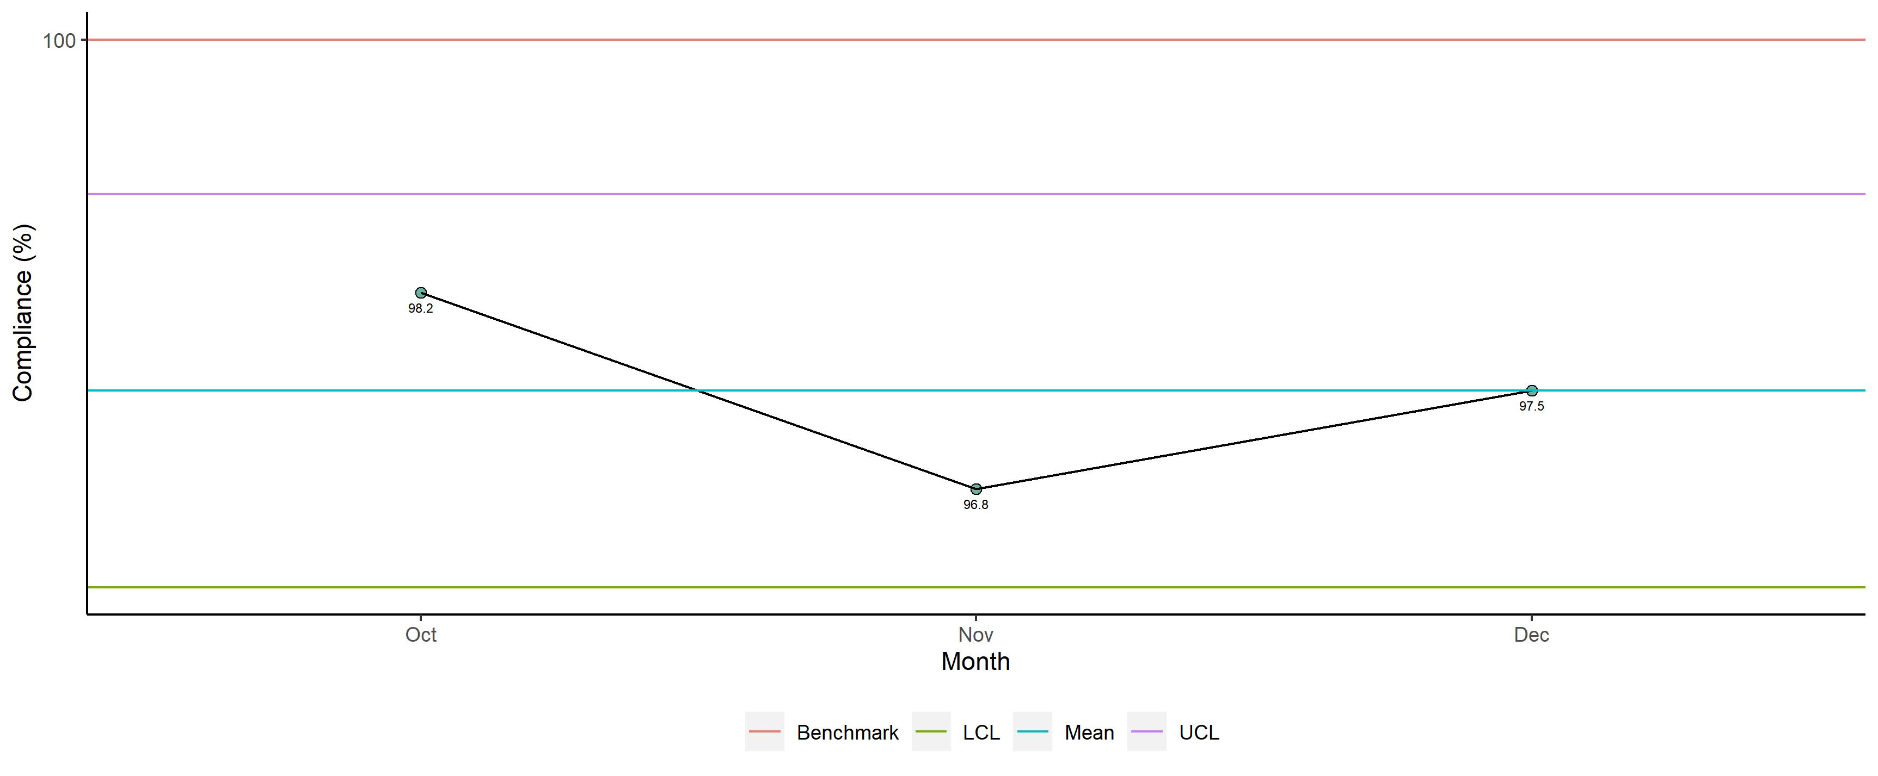
FMC Nurses - Availability of Required Documents

Slide 3
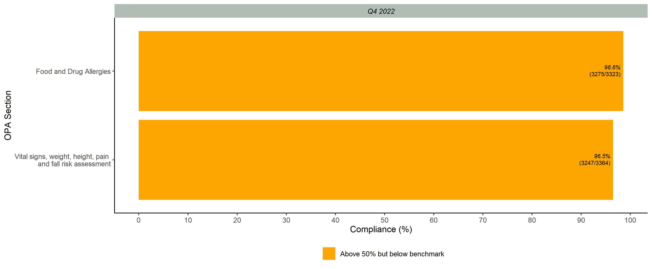
Documented Scores per OPA Section

Slide 4
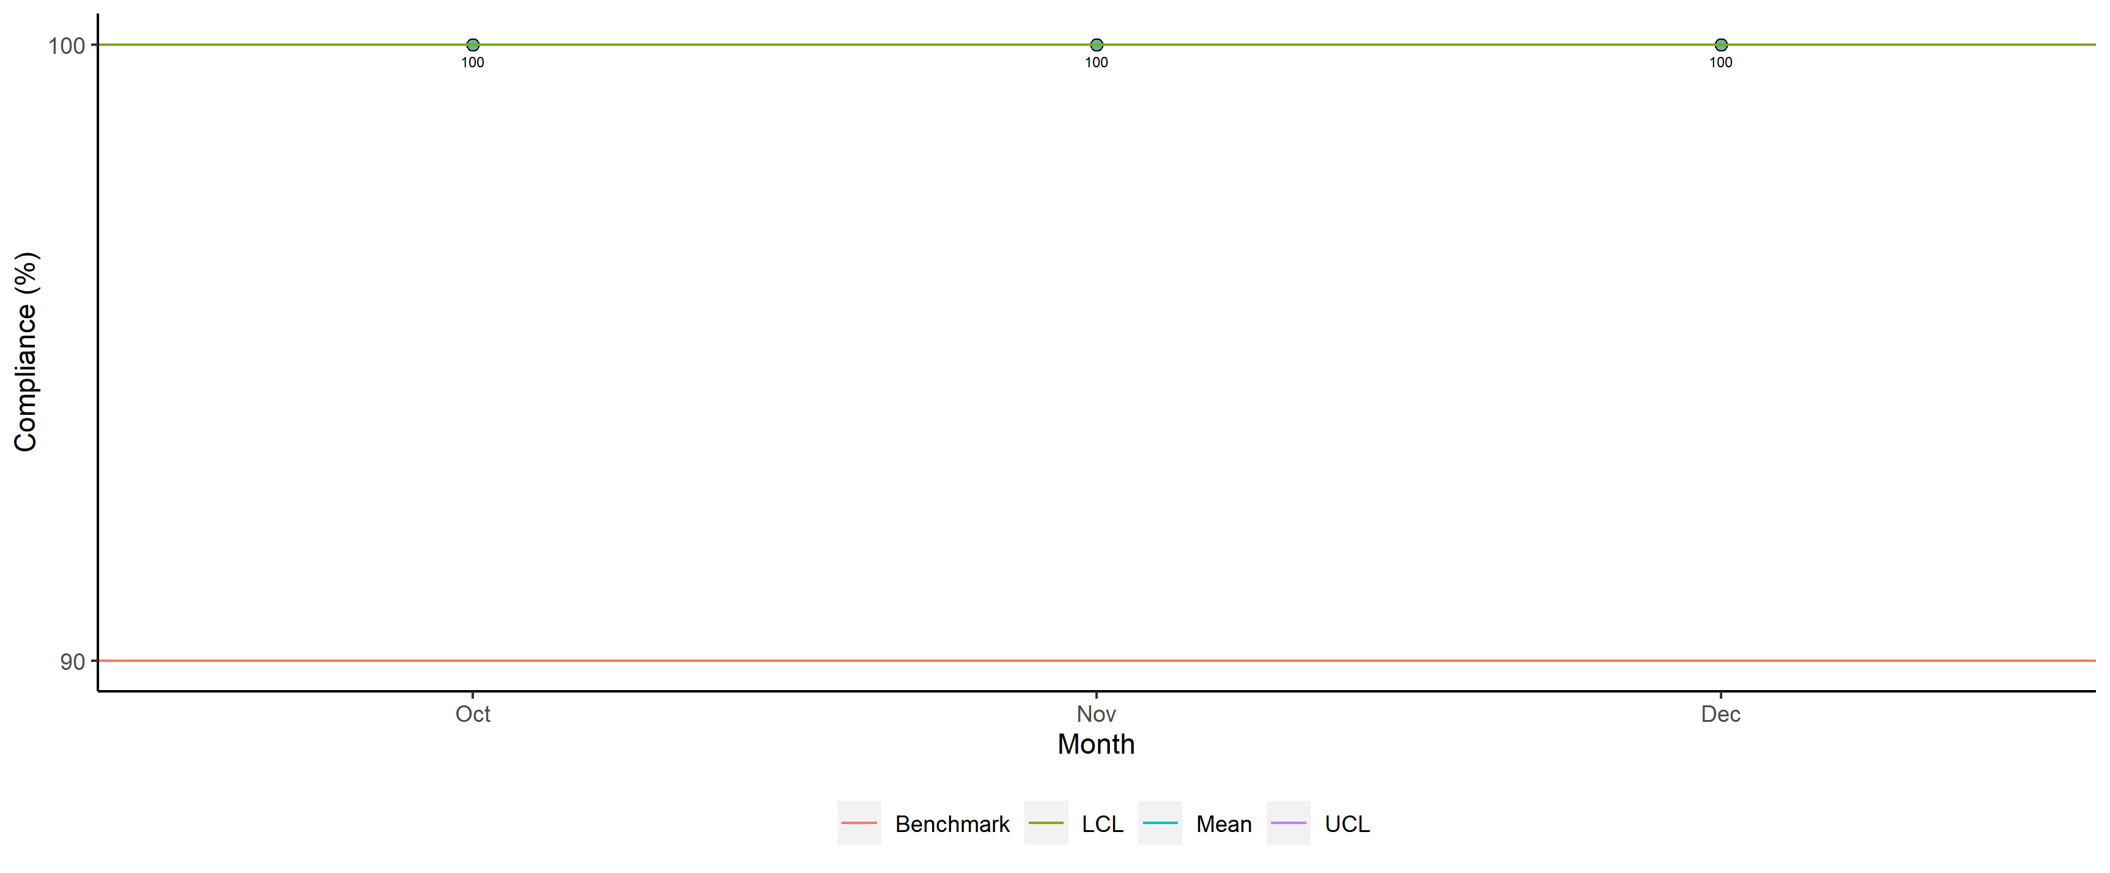
FMC Nurses - Legibility

Slide 5
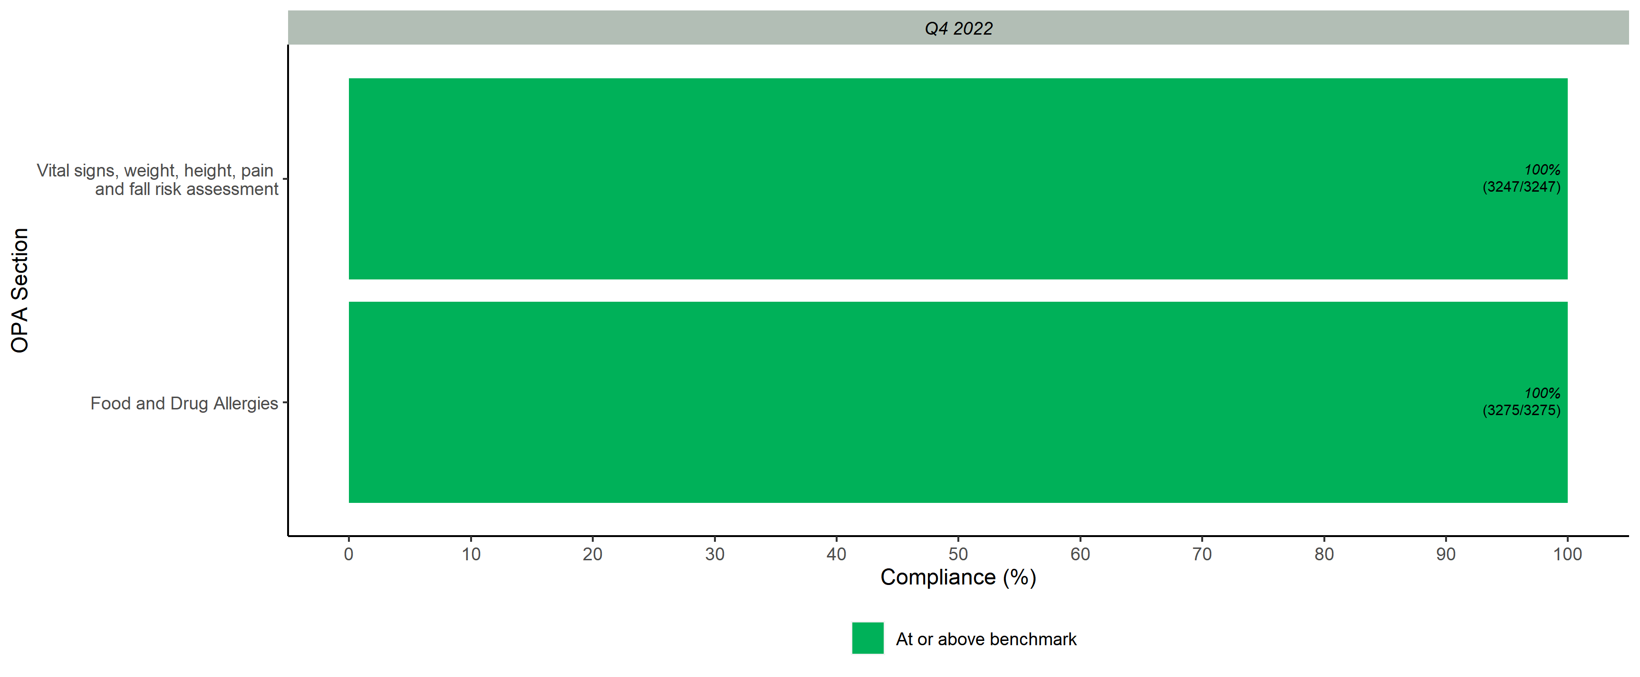
Legibility Scores per OPA Section

Slide 6
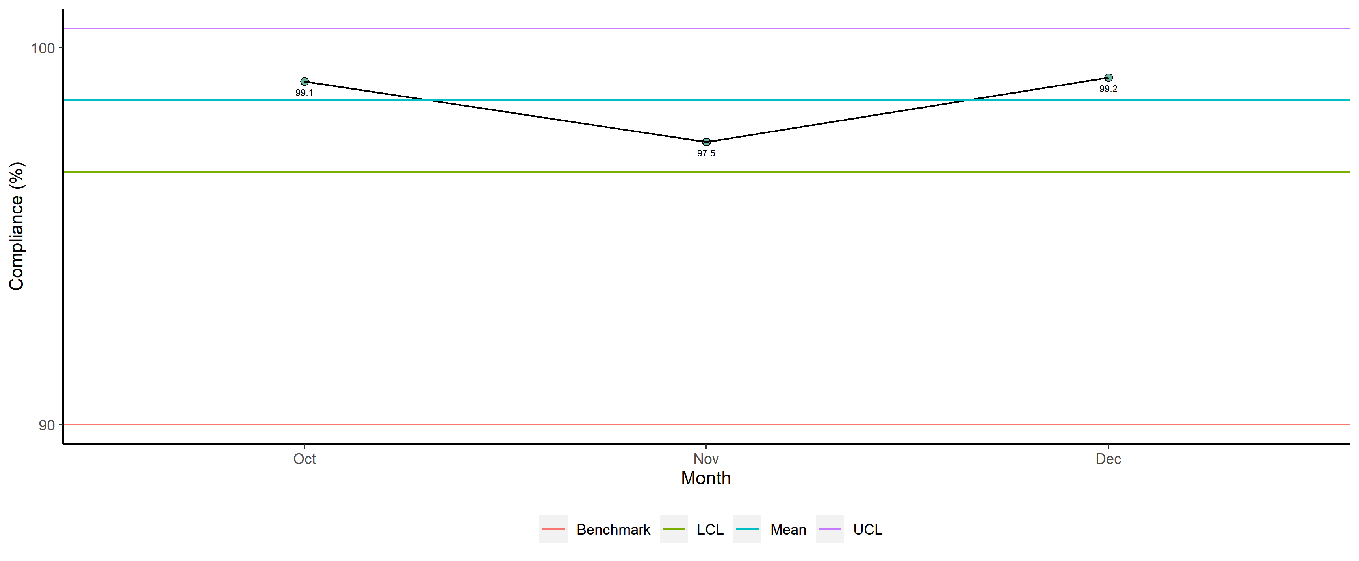
FMC Nurses - Completeness

Slide 7
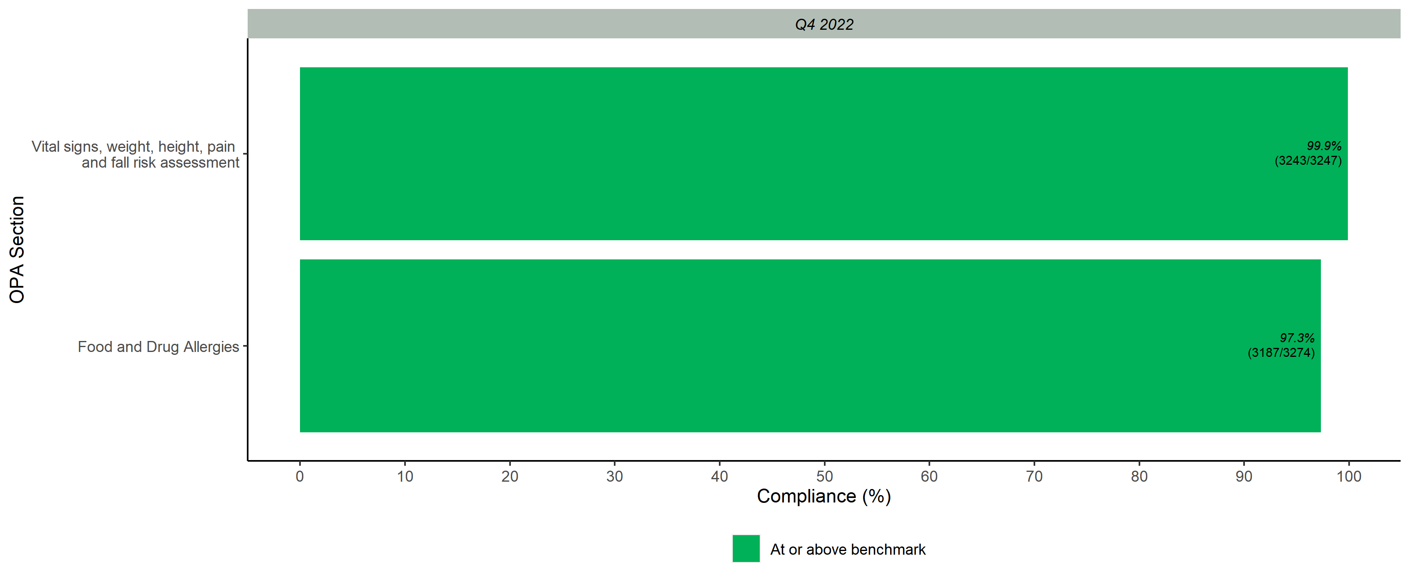
Completeness Scores per OPA Section

Slide 8
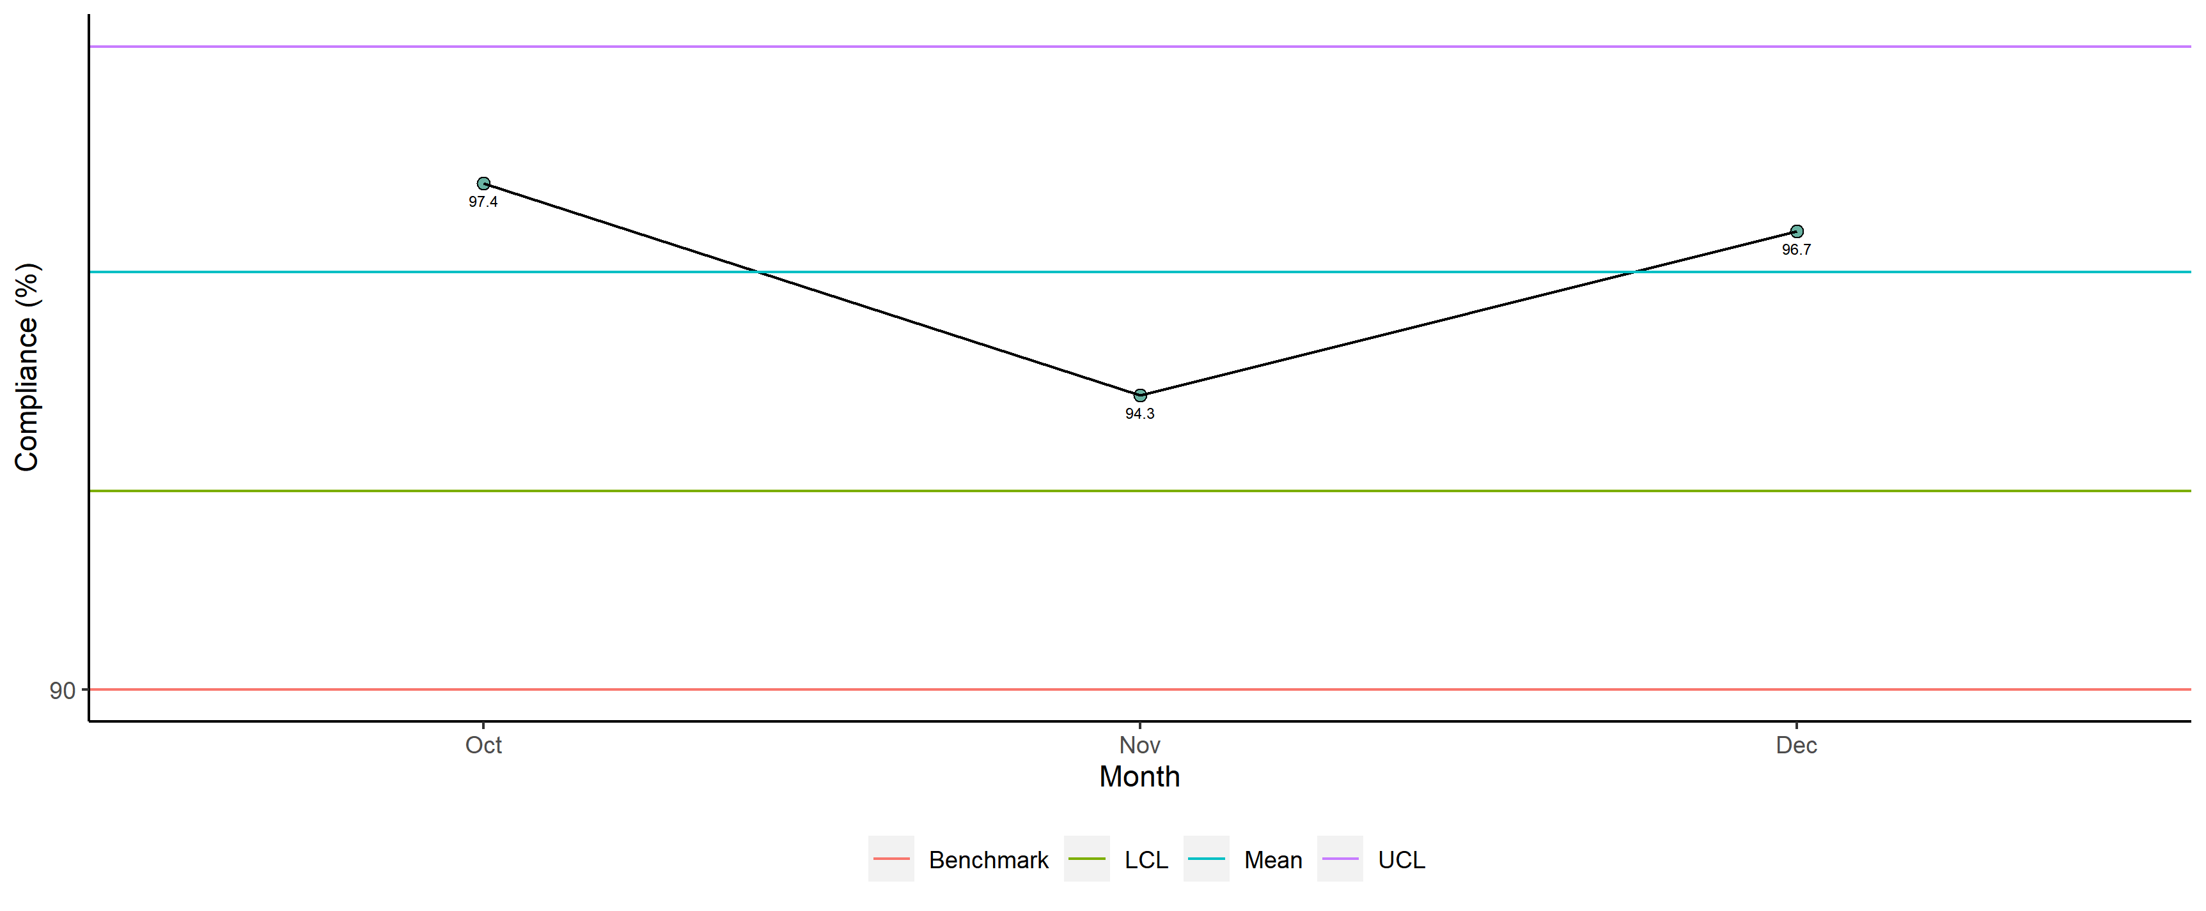
FMC Nurses - Overall

Slide 9
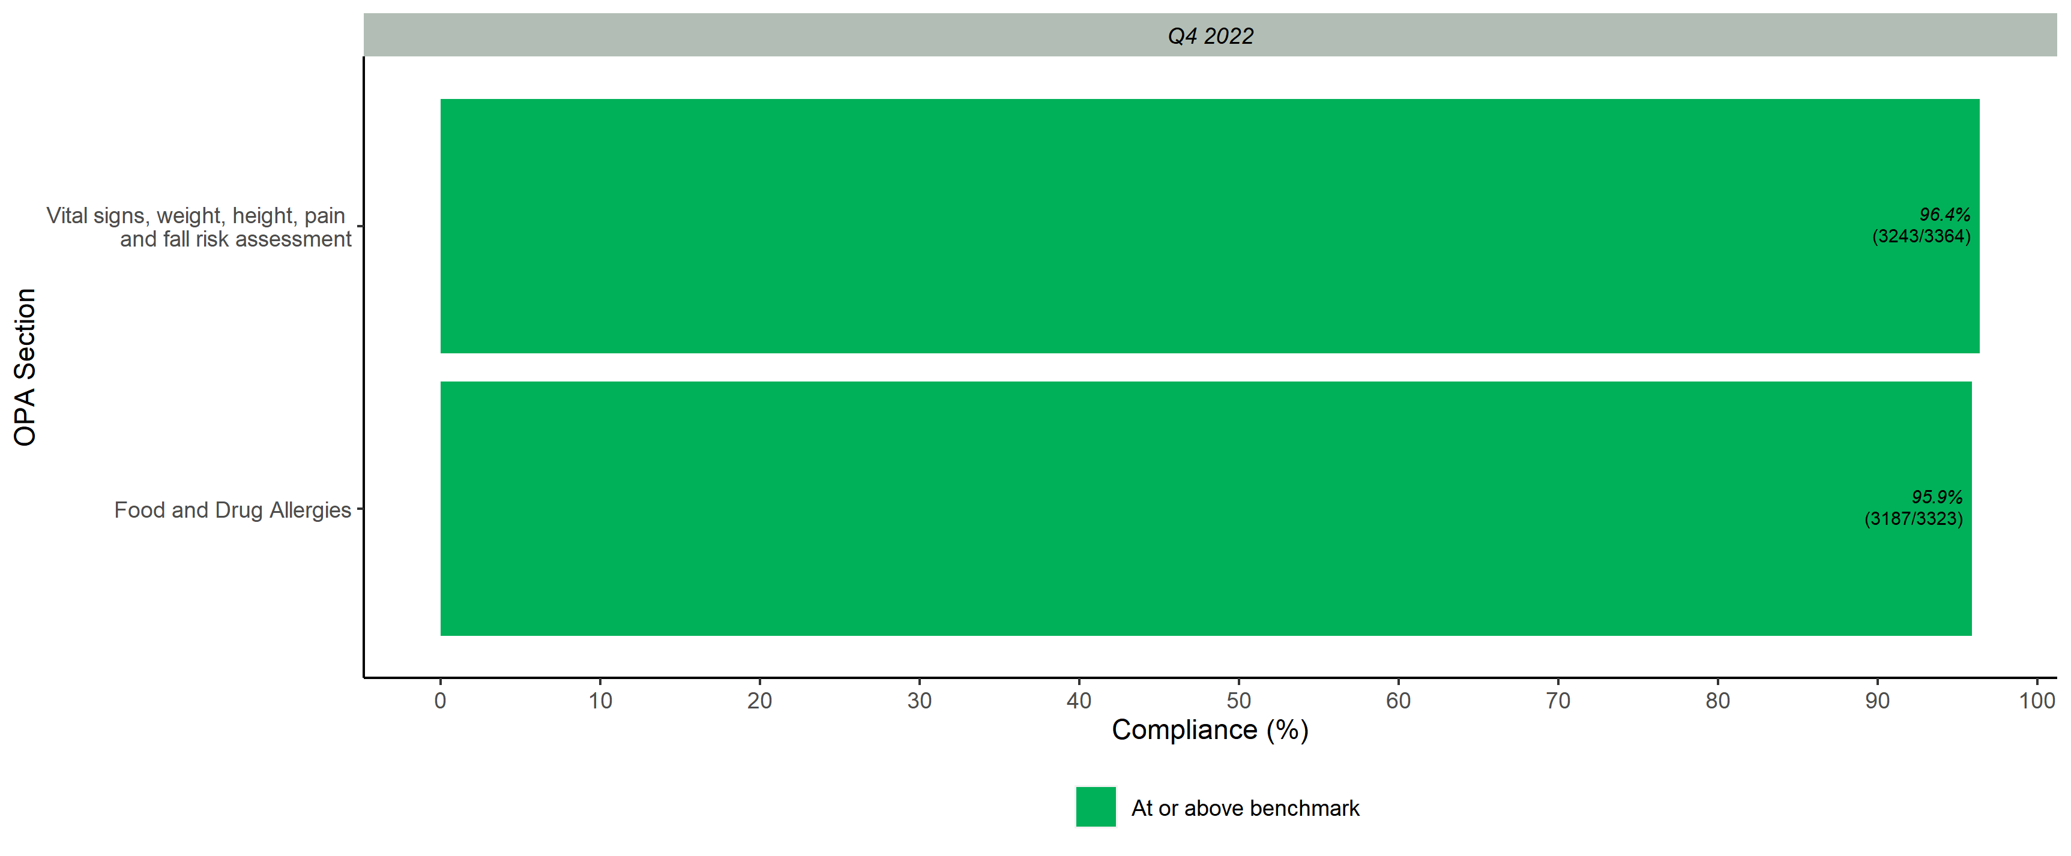
Overall Scores per OPA Section

